Slide 1
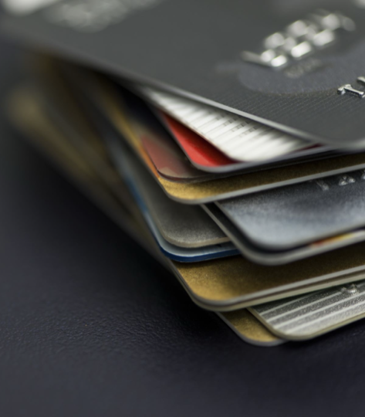


Portuguese Digital Wallet
EBSI - Verifier Credentials
Pedro Xavier|Pedro Pereira|Diogo Magalhães|Miguel Marques|Kim Peiter Jørgensen

Slide 2
AGENDA
EBSI - What is?
Verifier Credentials - What is?
EBSI - Actors
Examples of VC’s
Issuance, storage and presentation
Sequence Diagram - Issue Credential
Sequence Diagram - Verify Credential
Examples
Demo

Slide 3
EBSI - What is?
EBSI (European Blockchain Services Infrastructure) is a public, permissioned blockchain network that offers public APIs for interacting with its ledger.
It is the first EU-wide blockchain infrastructure, driven by the public sector, in full respect of European values and regulations, to create cross-border services for public administrations, businesses and citizens.

Slide 4
Verifier Credential - What is?
Verifiable credentials (or VCs) are a standard format for the digital representation of credentials that are cryptographically secure, verifiable through machines, and that guarantee privacy by enabling methods such as selective disclosure.
In simpler terms, Verifiable Credentials are secure digital documents containing information about a person or entity that can be easily shared and automatically verified.
VCs are standardized by several bodies, including the W3C.

Slide 5
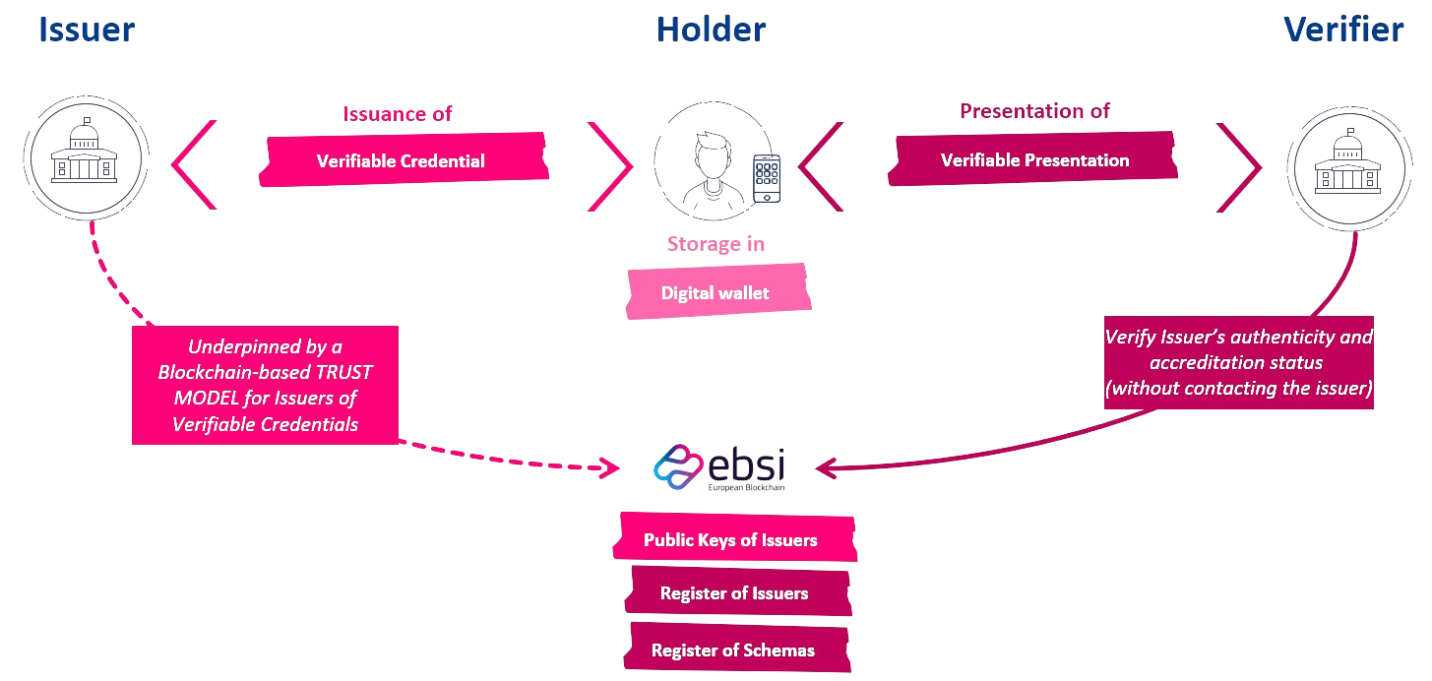
EBSI - Actors

Slide 6
Examples of VC’s
Any identity credentials, certificates, tickets, badges, and other personal documents you can think of can all take the form of Verifiable Credentials. Here are some of the most common types:
Identity Documents: VCs can include digital versions of government-issued identity documents, such as national ID cards, driver's licenses, passports, or any other official identification document you rely on.
Academic Certifications: Educational institutions can issue VCs for academic achievements, like diplomas, degrees, certificates, or transcripts.
Health Records: Verifiable health records, vaccination certificates, or medical test results enable the secure and private sharing of health information.
Membership Cards: VCs can be used for loyalty programs, club memberships, or employment ID cards providing proof of membership to a particular service or community.

Slide 7
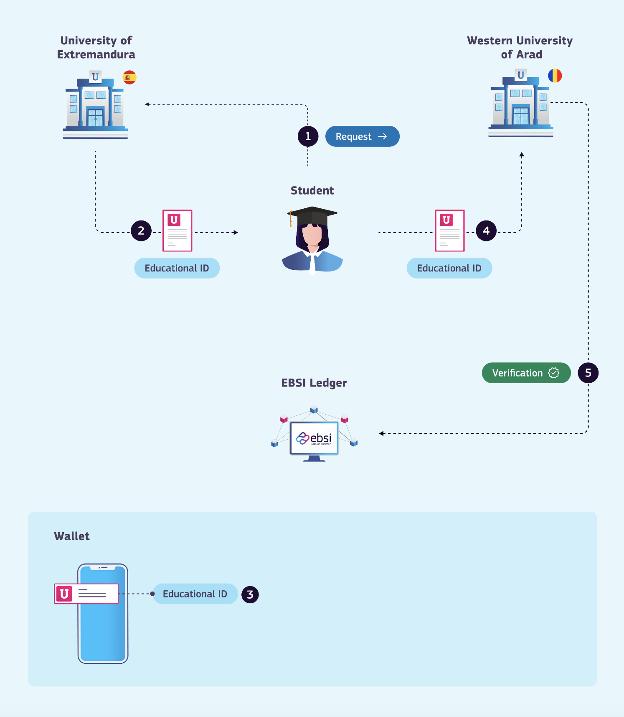
Issuance, storage and presentation

Slide 8
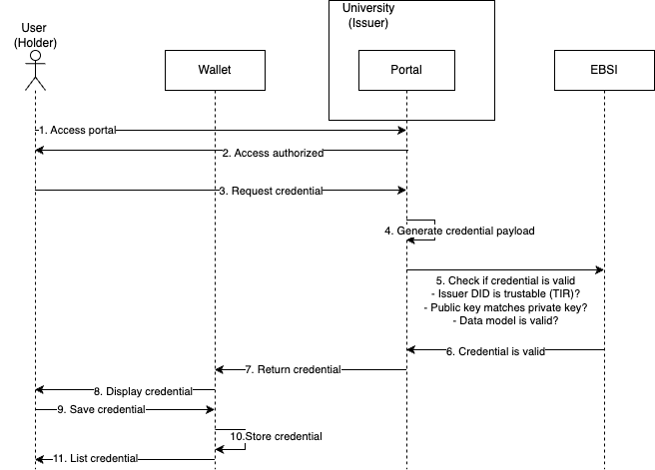
Sequence Diagram – Issue Credential

Slide 9
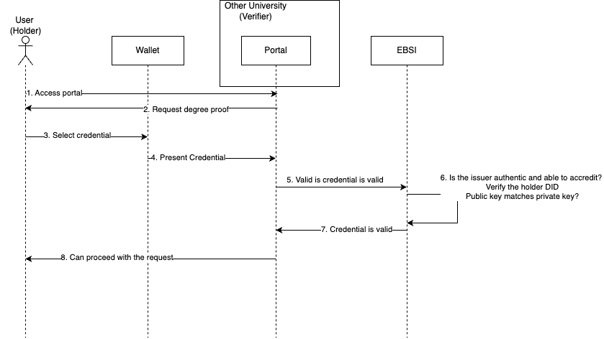
Sequence Diagram – Verify Credential

Slide 10
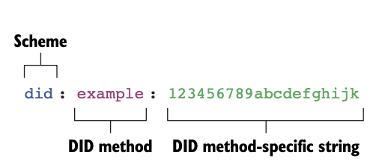
Example - DID

Slide 11
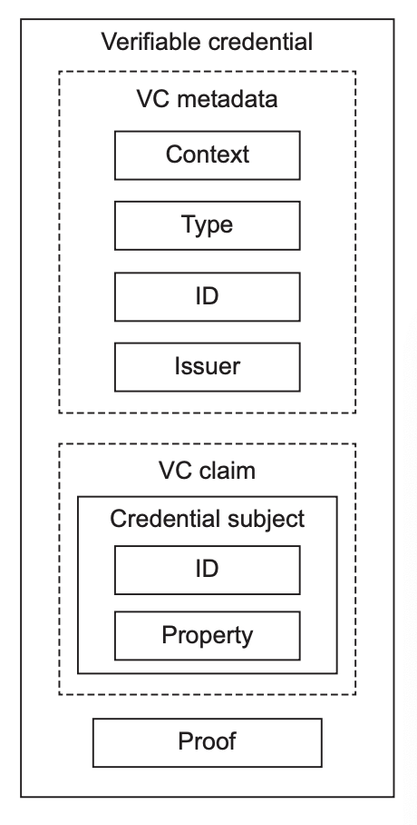
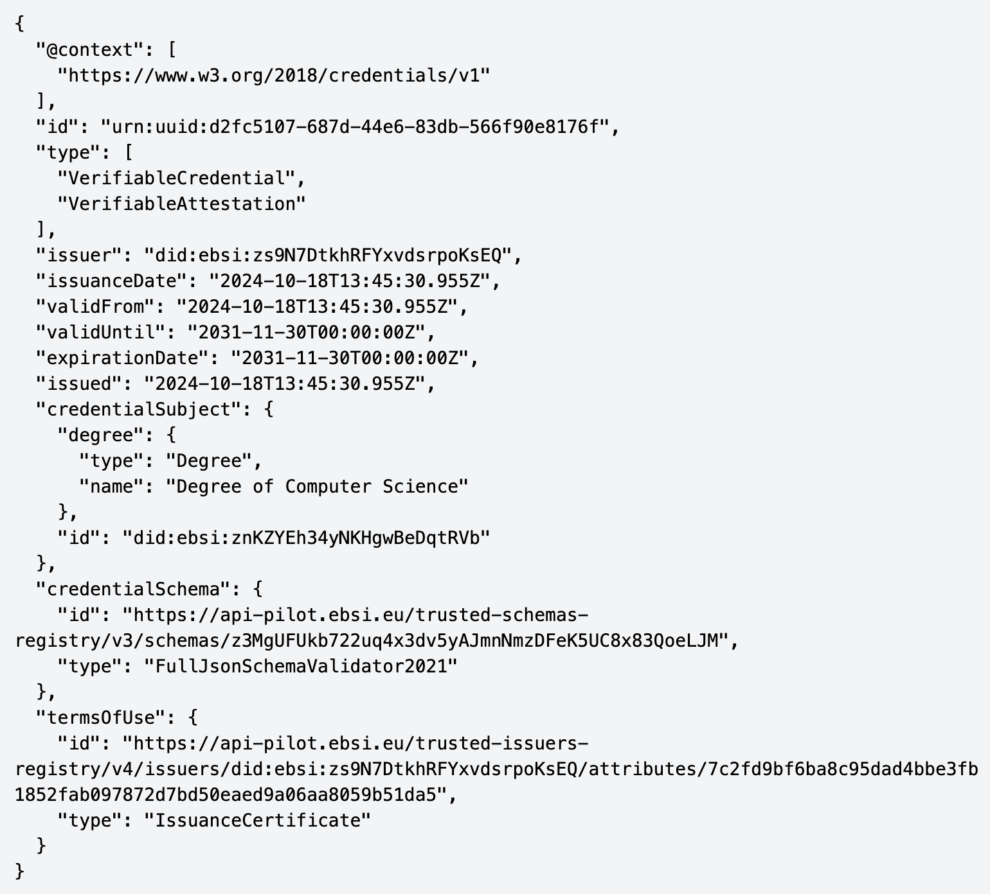
Example - Verifiable Credential

Slide 12
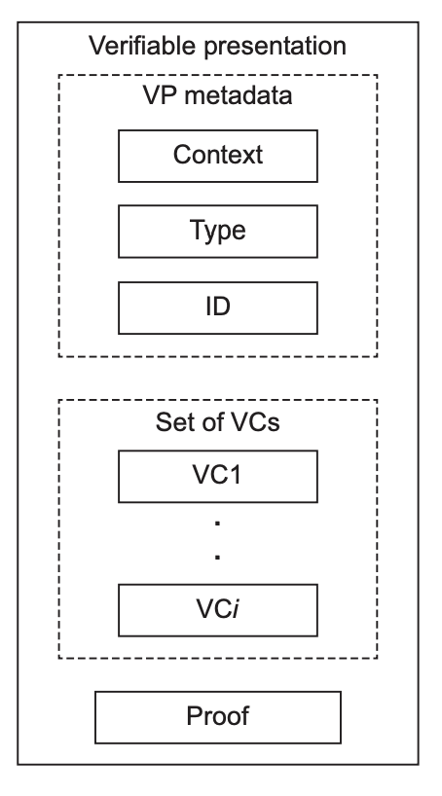
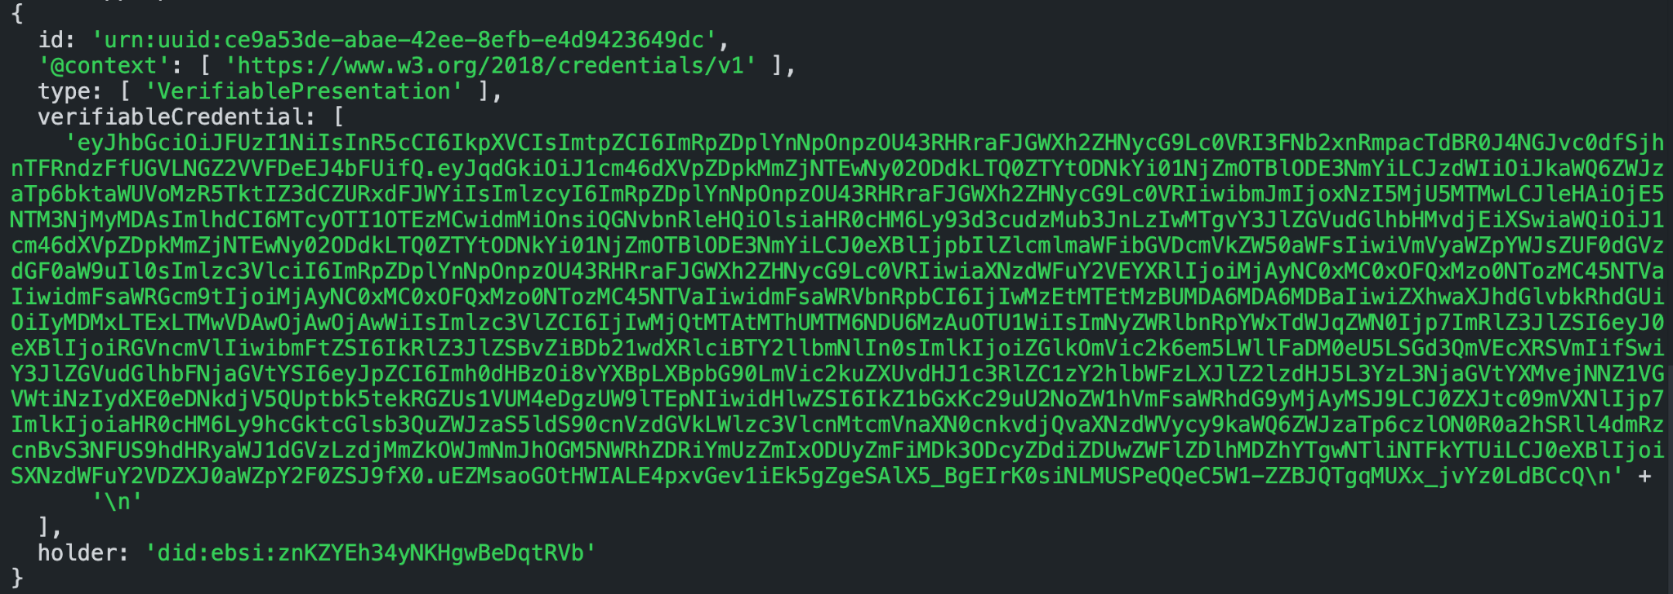
Example - Verifiable Presentation

Slide 13

DEMO

Slide 14
DEMO AGENDA
Setup wallet (holder)
Issue credentials (issuer)
Store and list credentials (holder)
Present credentials (holder)
Verify credentials (verifier)

